Slide 1
CO2 emissions around the world
Presentation by: Shree & Mahaprasad

Slide 2
Data Dictionary

Slide 3
SRNO | Attribute name | Attribute definition | Broad category | Sub category | Scale of Measurement
1 | Country Name | Name of country | Qualitative | - | -
2 | Country Code | Unique code of country | qualitative | - | Nominal
3 | Region | Country lie in which continents | qualitative | - | -
4 | Indicator Name | CO2 emissions (metric tons per capita) | qualitative | - | -
5 | 1990 | From which year we have data | quantitative | Continuous | -
6 | 1991 | …….. | quantitative | Continuous | -
7 | 2018 | ……….. | quantitative | Continuous | -
8 | 2019 | Till date | quantitative | Continuous | -

Slide 4
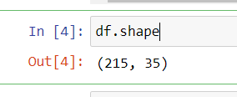
Dataset size
215 rows, 35 columns

Slide 5
Descriptive Statistics

Slide 6
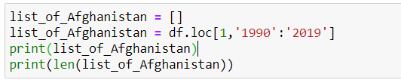
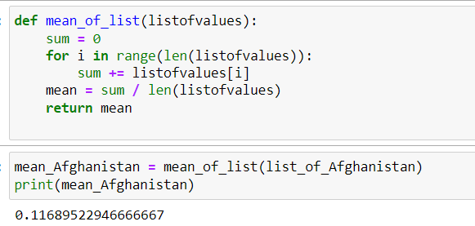

Afghanistan’s analysis
Average emission over the years

Slide 7
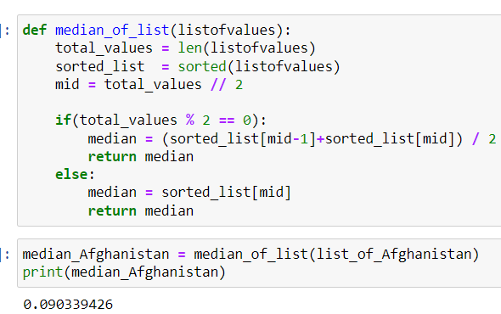
Median emission over the years

Slide 8
Mode emission over the years
Not possible to find since there are no repeating values

Slide 9
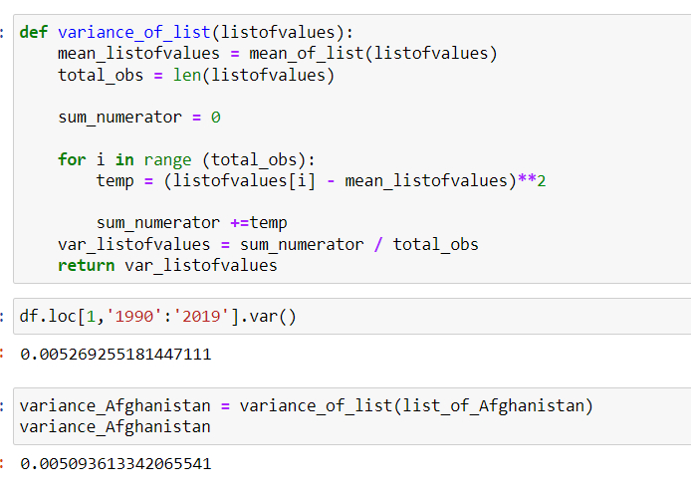
Variance emission over the years

Slide 10
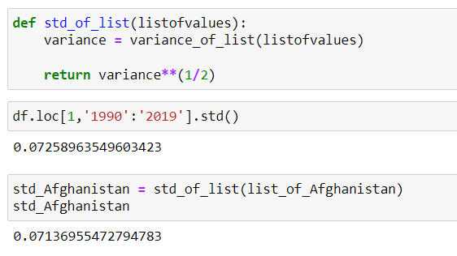
STDDEV emission over the years

